Slide 1
Composite Manufacturing
Atul JAIN
#All images from internet or book “Comprehensive Composite Materials”

Slide 2
Learning Outcomes
Different methods for fabricating composites
Strengths and weakness of different methods
Fiber architecture and manufacturing methods
Better perspectives about different assumptions made in the models developed later in the course
Different considerations while choosing manufacturing method

Slide 3
Different methods of composite manufacture
Hand layup
Vacuum bag moulding
Autoclave
Compression molding
RTM
Filament winding
Injection molding
3D Printing (of composites?)

Slide 4
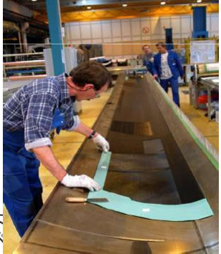
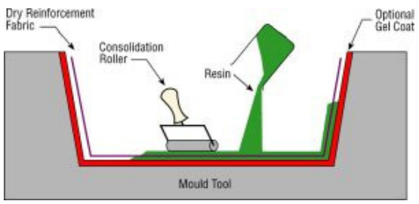
Hand layup
Fabric layers are laid by hand
Stack is made
Use a combination of heat and pressure
Minimal tooling costs

Slide 5
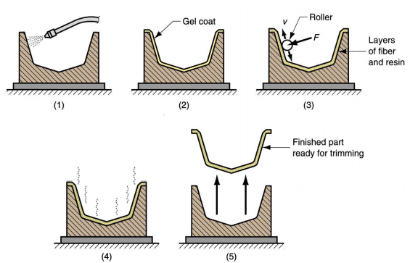
Step by step hand molding
Low cost
Time consuming process

Slide 6
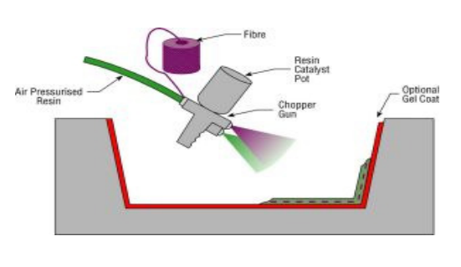
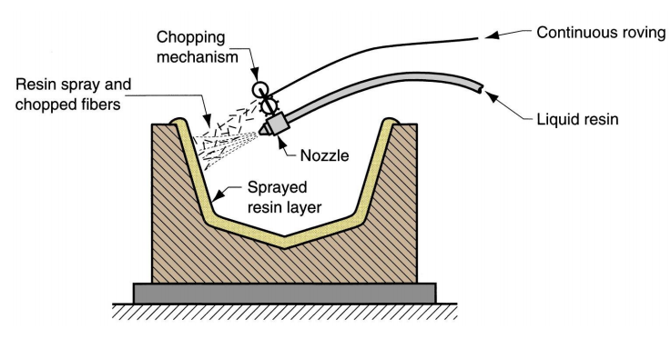
Spray layup
Attempt to mechanize the hand layup process
Shorter fiber length
Random orientation

Slide 7
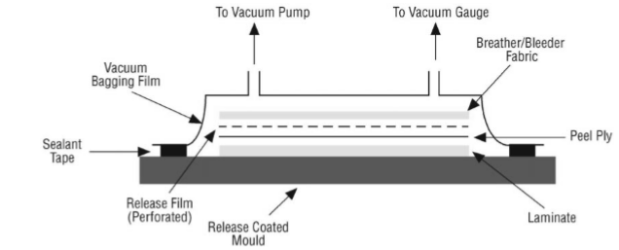
How to apply pressure?
Total time can be reduced by introducing pressure
Vacuum bag with breather assembly is used

Slide 8
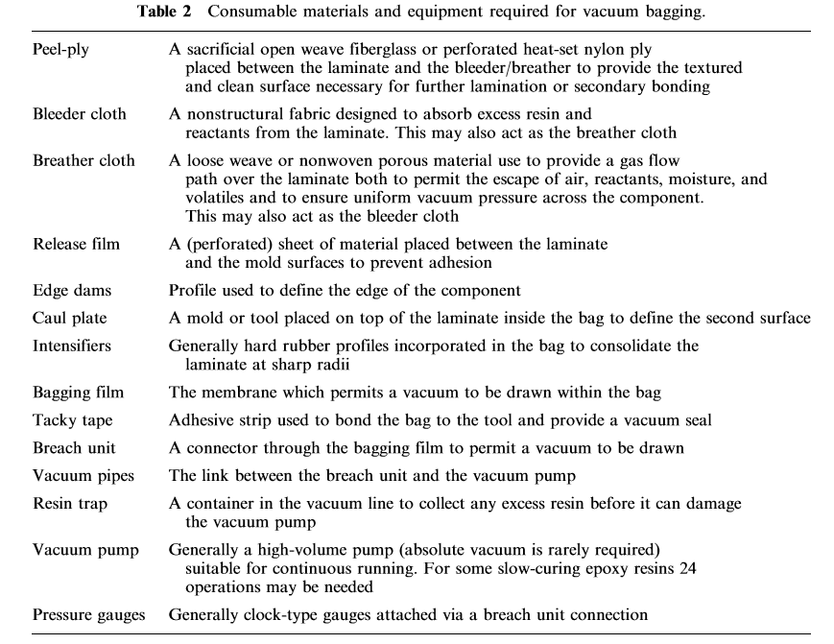

Slide 9
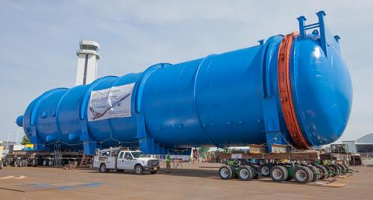
Autoclave
Autoclave used for wing of Boeing 777

Slide 10
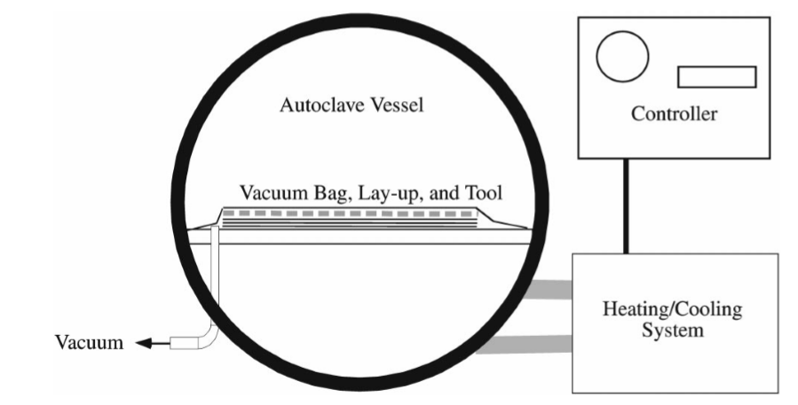
Inside an autoclave

Slide 11
Process
Step 1: Lay up the different lamina layers (manual or automated)
Step 2: Apply pressure to balance the pressure between the environment and autoclave
Step 3: Laminate + vacuum infrastructure subject to heat and pressure (some specific order)

Slide 12
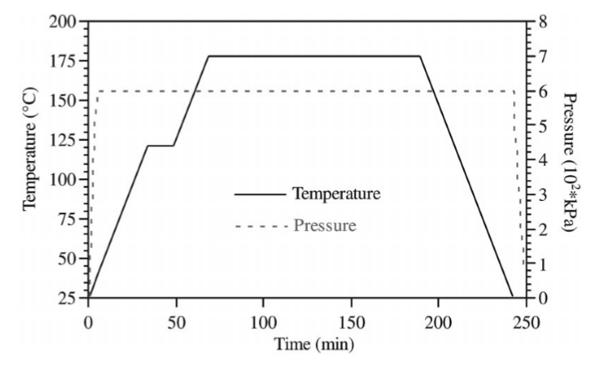
To allow the matrix to completely penetrate the fiber
Pressure is increased rapidly
To allow the complete cure of the matrix
Temperature increases at a ramp

Slide 13
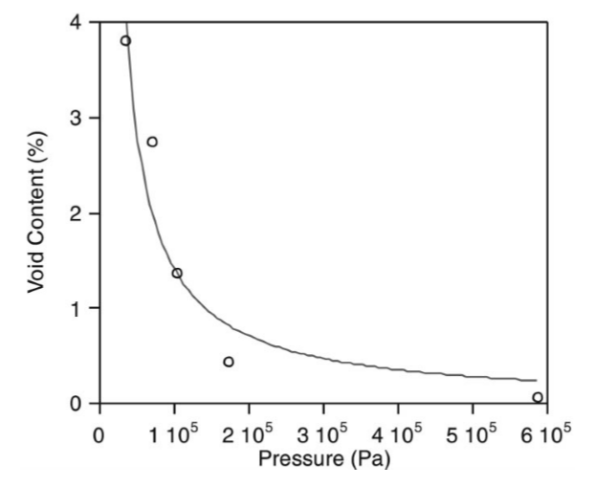
Challenges & Opportunities
Autoclave leads to highest quality composites
Hard to control the reactions, and crushing of cores
Very high pressure is needed to control the voids

Slide 14
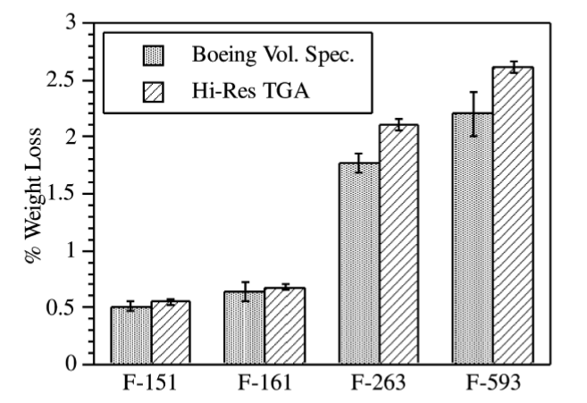
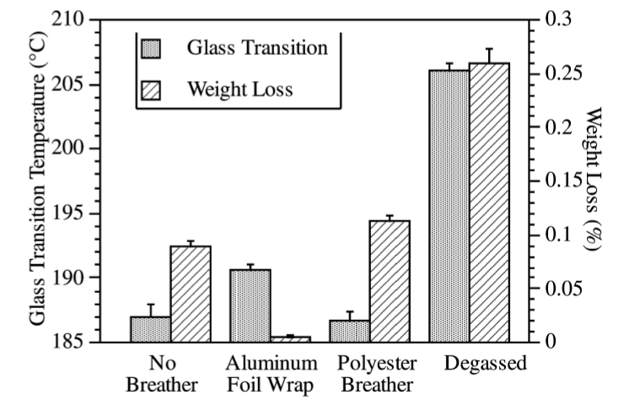
Volatile removal
Most composites have volatile content ~3%
Autoclave removes only 0.15%
Hampers the performance of composite at rough environment

Slide 15
Energy Expensive method
Large amount of energy is needed to start and maintain high temperature and pressure inside autoclave
Solution: Electron beam curing- works like microwave and heats only the composite laminate

Slide 16
Autoclaves
Aerospace industry almost exclusively uses this method of composite fabrication
Long hold time and expensive equipment make it unviable for automotive industry
FUTURE IS Out Of Autoclave Molding!

Slide 17
Resin infusion processes
Family of methods which consist of
- Resin Transfer Molding (RTM)
- Vacuum assisted Resin Transfer Molding (VARTM)
- Seemann composite resin infusion molding process (SCRIMP)
- Injection compression molding (ICM)

Slide 18
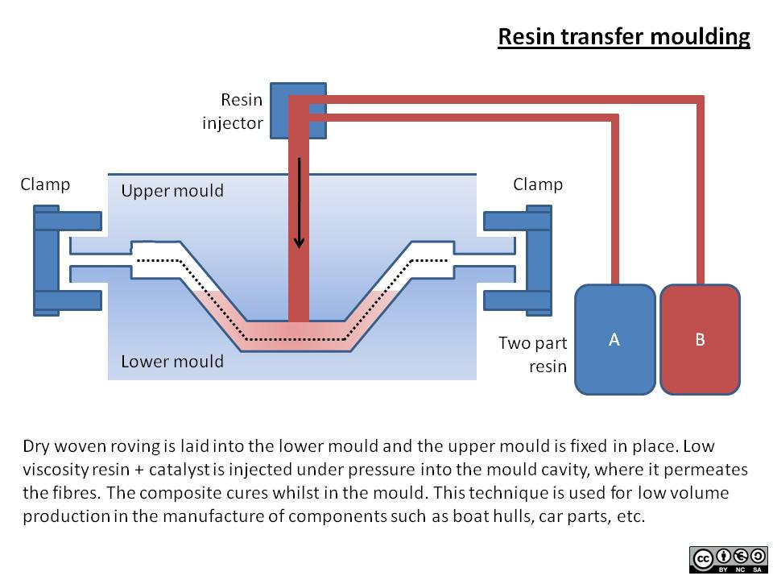
Resin Transfer Molding

Slide 19
Advantages
No need for autoclave
Possible to make materials with different cores or hollow shapes
Good finishing
Possibility to automate

Slide 20
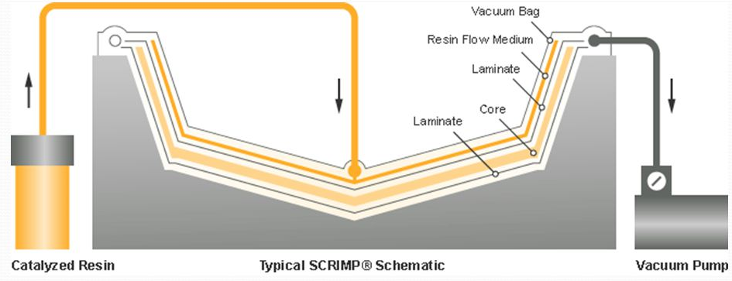
VARTM
Same principle as RTM.
Key difference is that in RTM matrix is pumped
In VARTM, resin is pulled by vacuum

Slide 21
Drivers and design considerations
Key driver for these processes is low initial investment
Design possibilities: Possibility to integrate metal inserts, different resin content in different locations
Limitation: Cycle time is long, scaling up production is hard

Slide 22
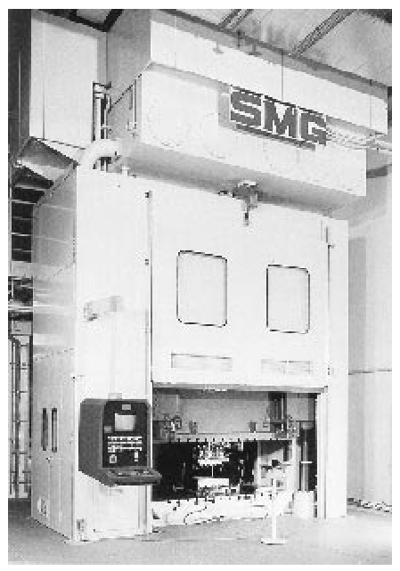
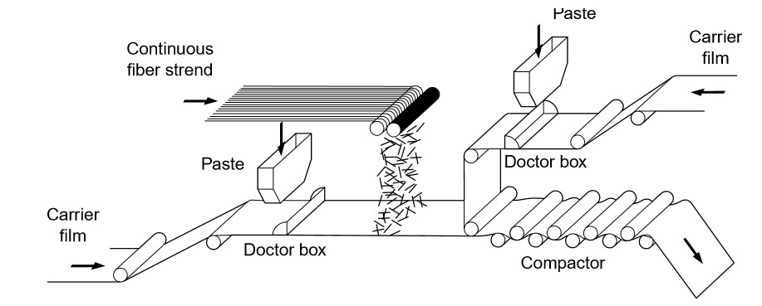
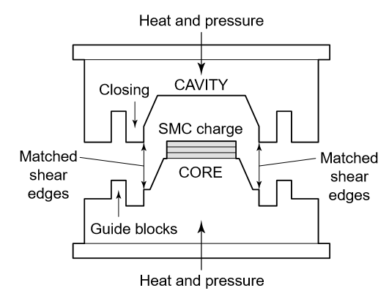
Compression molding
High volume molding method!

Slide 23
Steps
Mold is closed
Pressure is applied on closed mold
Press is opened
Low pressure causes:
Blisters, uneven resin distribution
High pressure causes:
Warpage of composites and deformation of mold
Most Critical step

Slide 24
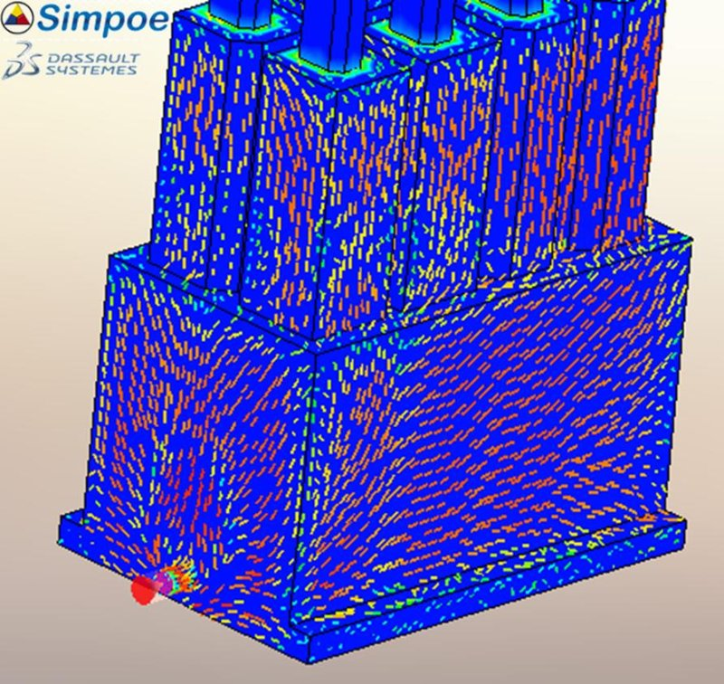
Applications
Very popular for automotive applications
Almost never used by aerospace industry
High variability in properties, simulation is challenging!

Slide 25
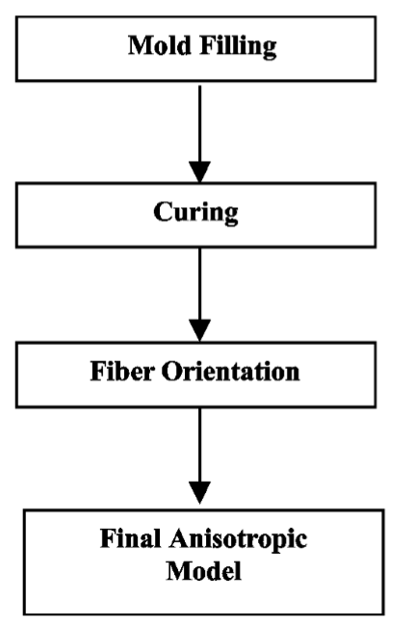
Different steps of simulation

Slide 26
Drivers and design considerations
Key driver is cost and weight reduction- 60% cheaper and 25% lighter than steel
Design considerations – curvatures, uneven thickness freedom
Limitation in design is that flow induced fiber orientation cannot be controlled

Slide 27
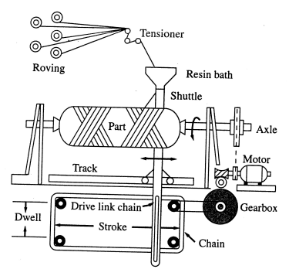
Filament winding
Resin-impregnated continuous fibers are wrapped around a rotating mandrel that has the internal shape of the desired FRP product

Slide 28
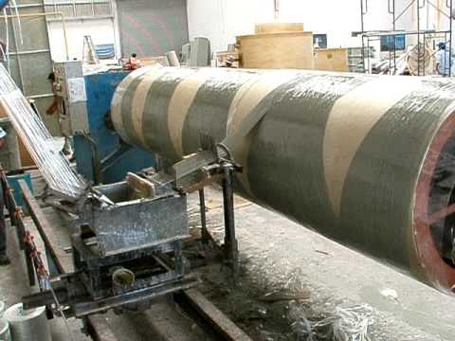

Slide 29
Advantages and applications
Highly automated
Complex shape can be made
Composite material has high hoop strength
Golf sticks, fishing sticks, shipping industry
Glass fibers

Slide 30
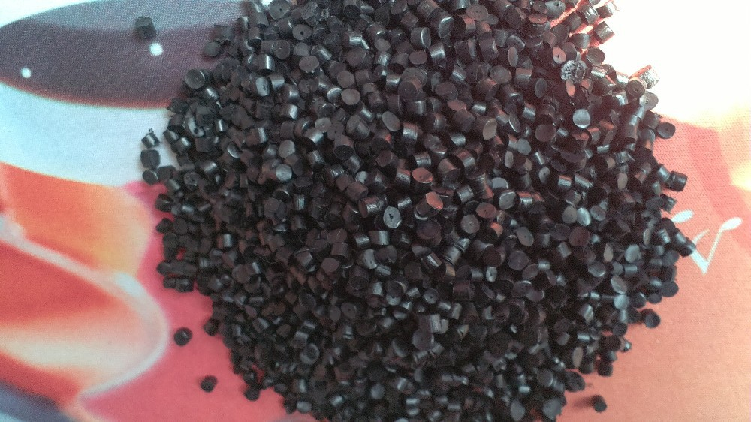
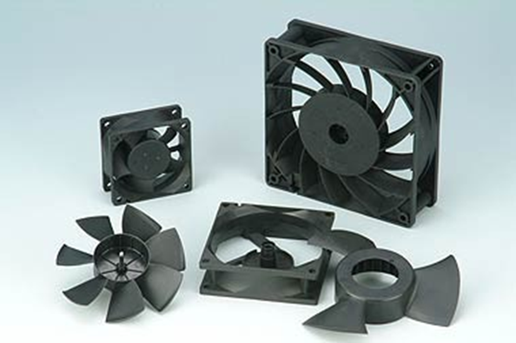
Injection molding
Extrusion
Injection molding
Two stage process is typically used
matrix
fiber
Precompounded pellets

Slide 31
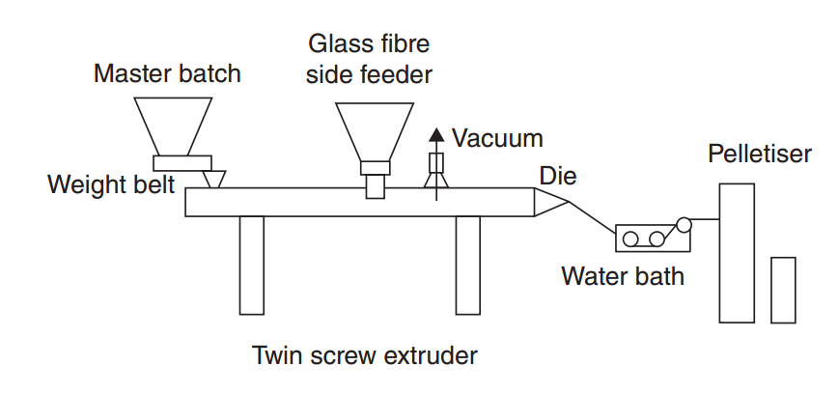
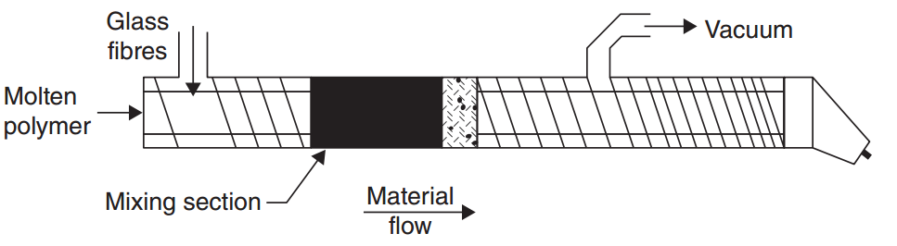
Extrusion process

Slide 32
Fiber breakage during extrusion
Fiber breakage takes place in the screw
Screw surface
Direction of flow in the extrusion drum
Fiber breakage results in
Decrease in fiber length
Non-uniform distribution of fiber length

Slide 33
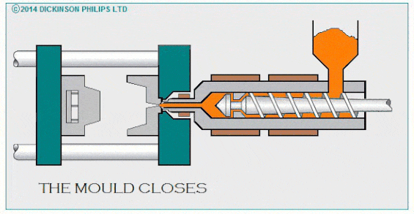
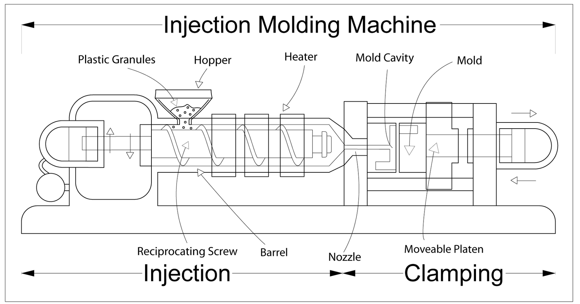
Injection molding process
http://dickinsonphilips.com/process/
Melted mixture of matrix and fiber is injected to mold under high pressure (upto 20,000psi)

Slide 34
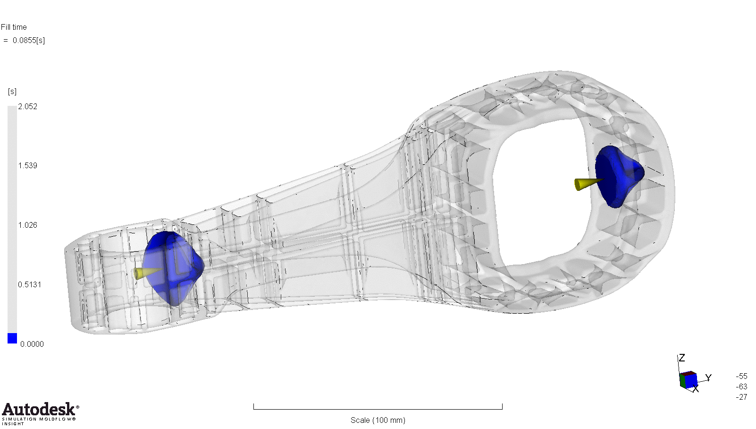
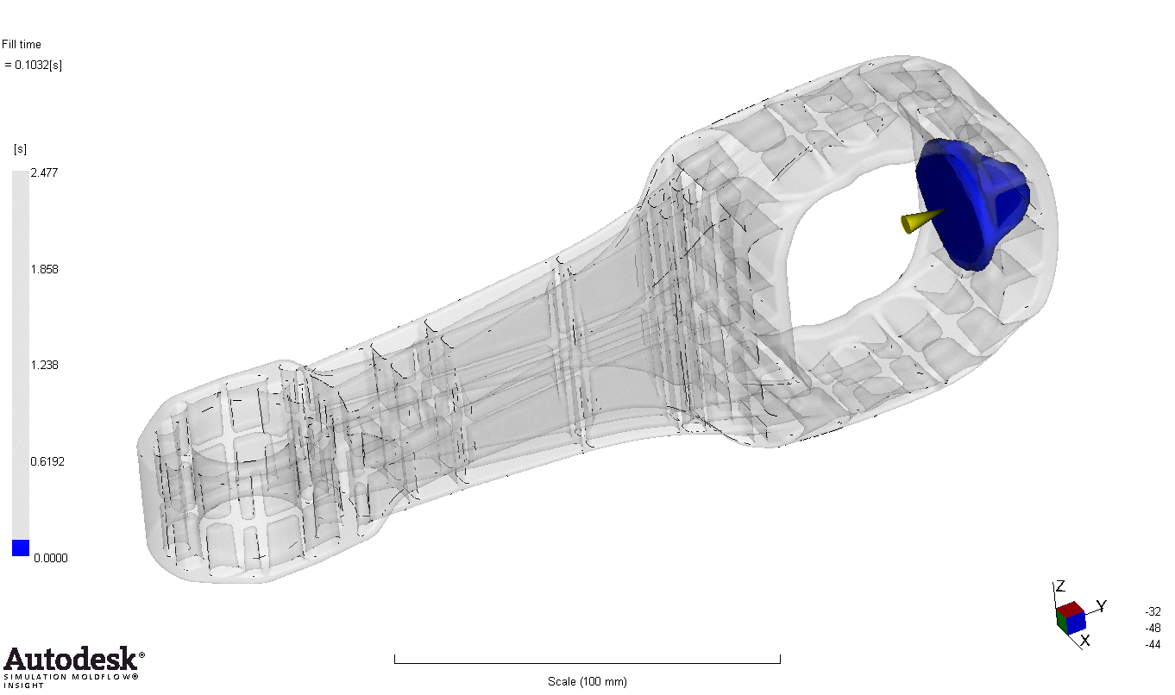
Simulation

Slide 35
Modern manufacturing methods
Automated tape layup
Centrifugal casting
3D Printing

Slide 36
General consolidation quality
Matrix based porosity
Inter bundle voids
High internal stress-warpage
Matrix degradation
Change in fiber architecture

Slide 37
Driving forces for composites
Save weight
Increase mechanical properties
Reduce number of elements
Unique combination of properties
Shaping freedom
At a REDUCED cost!!

Slide 38
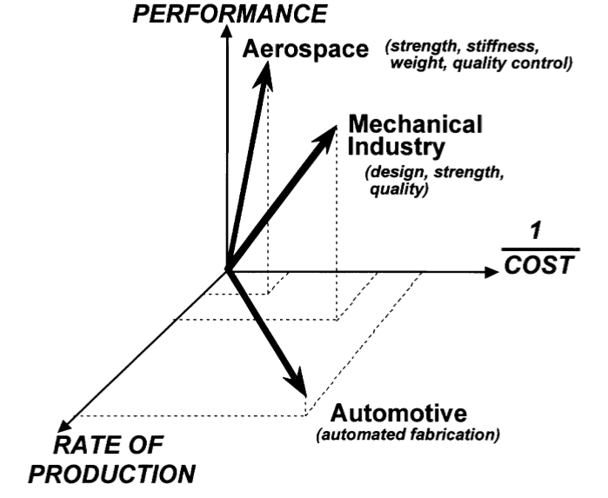

Slide 39
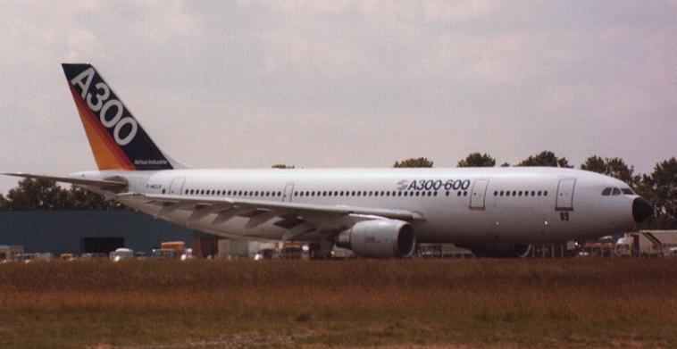
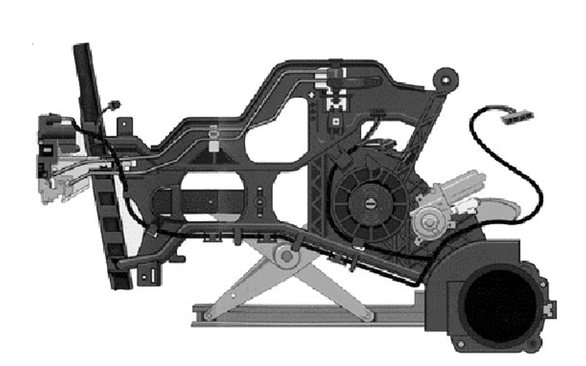
Flat shape
complex shape

Slide 40
Materials
The choice of fiber and matrix dictates the manufacturing process to be used
Matrix: Thermoset or Thermoplastic
Thermoplastics have high melt viscosity, high processing temperature, quick setting time (no crosslinking is required)

Slide 41
Fiber reinforcement type

Slide 42
Orientation Control
Fiber alignment leads to higher stiffness
Some process lead to greater orientation control
Longer the fiber, easier it is to control the orientation

Slide 43
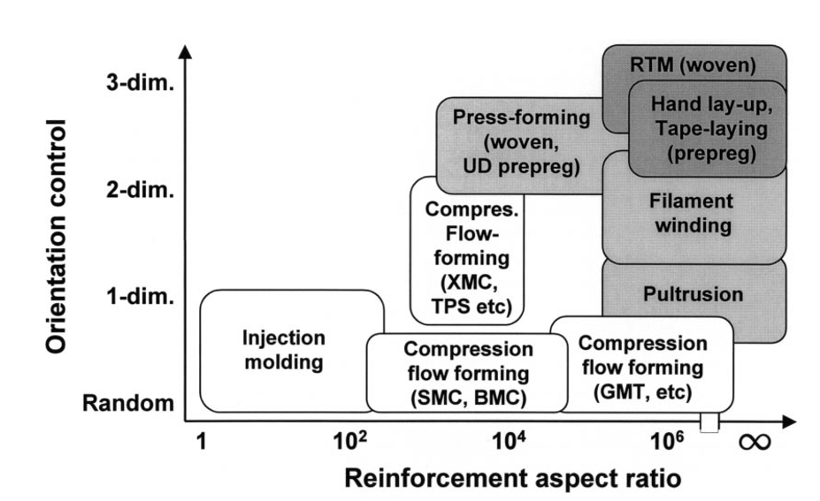

Slide 44
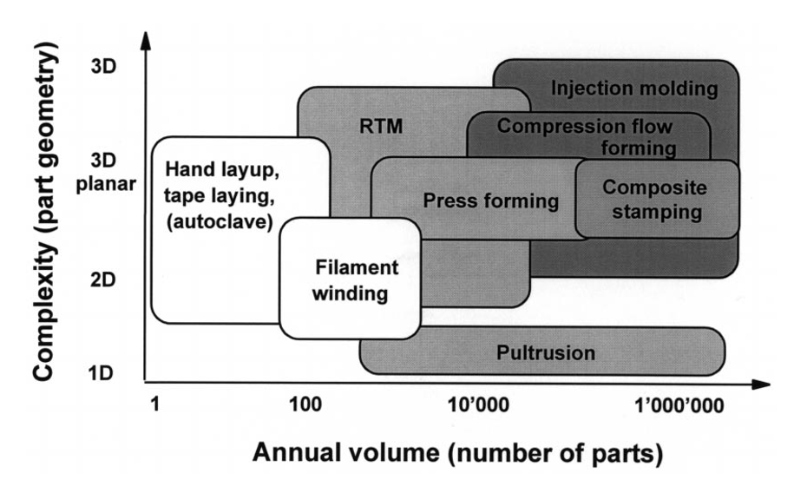
Shape Complexity vs. Annual Volume

